Slide 1
Introduction to Electrical Circuits Final Term Lecture - 01
Faculty Name: Mr. A N M Shahebul Hasan
Email ID: shahebul@aiub.edu
Reference Book:
Introductory Circuit Analysis
Robert L. Boylestad, 11th Edition

Slide 2

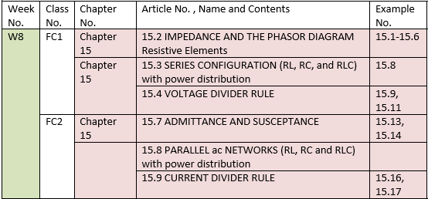

Slide 3
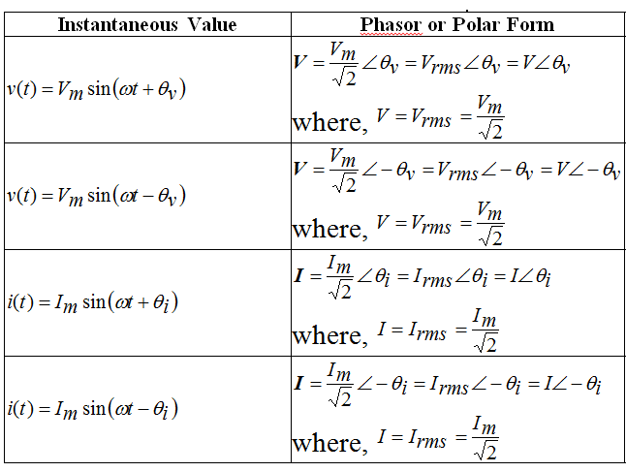
Instantaneous Value to Phasor or Polar form

Slide 5
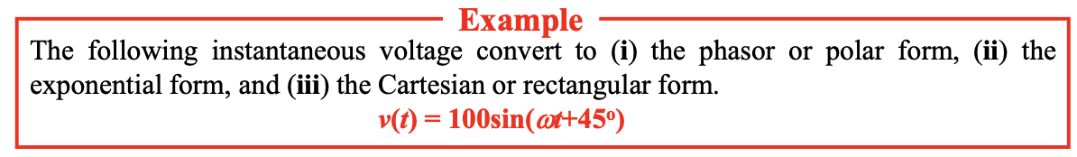
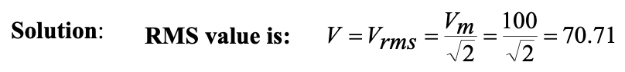
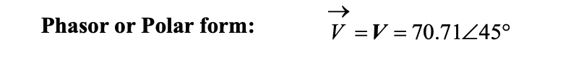

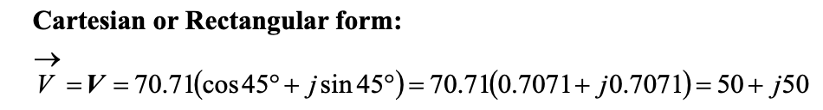

Slide 6
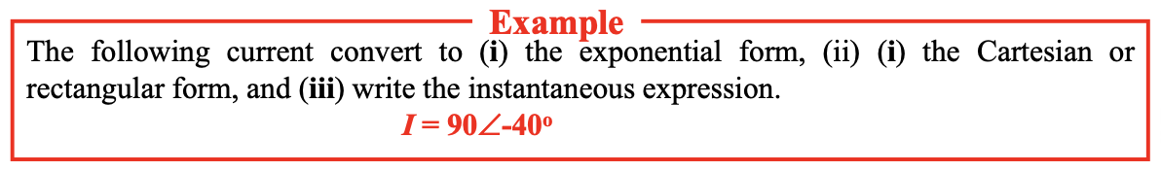
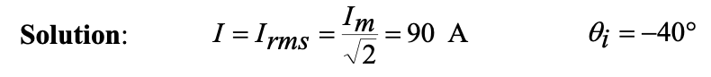

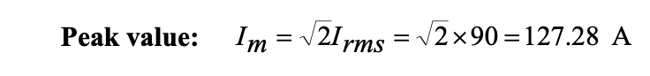
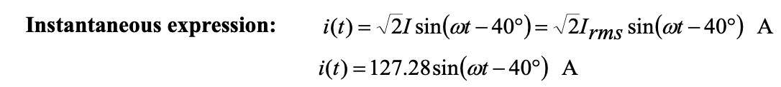

Slide 7
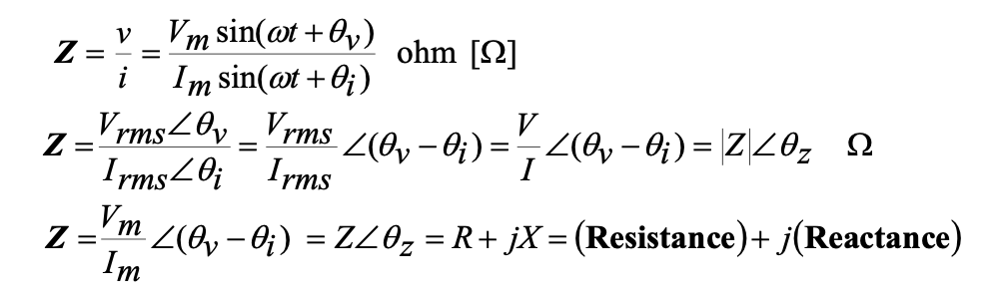
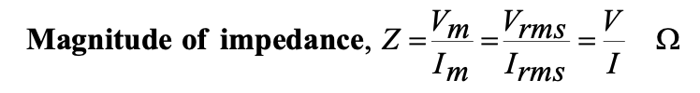
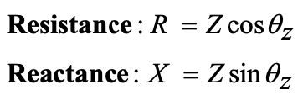
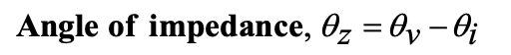
Impedance
According to ohm’s Law, Impedance is the ratio of voltage to current. The unit of impedance is ohm [Ω].

Slide 9
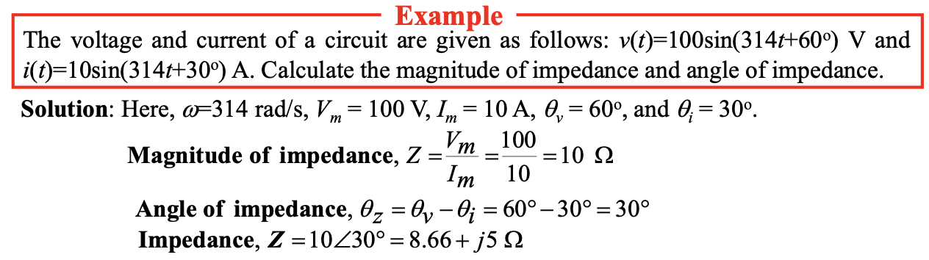
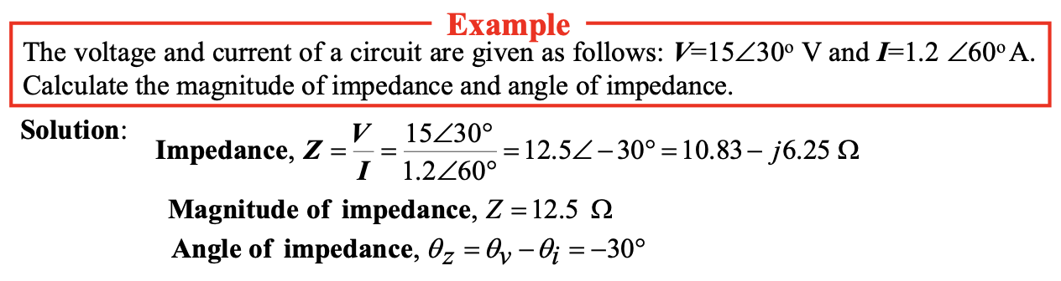

Slide 10
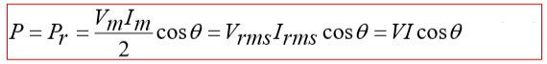
Instantaneous power can be written as follows:
p(t)= P − Pcos2ωt + Qsin2ωt [W]
The average values of second and third terms of above equation are zero, so the average value of total instantaneous power equals to the constant term which is called power (or average power or real or active or true or wattfull power).
The unit of real power is called watt.
The real power is measured by wattmeter.
The power or real power or active power or true power or wattfull power can be written as follows:
Physical Significance of Power or real power or average power:
The power (or average power or real or active or true or wattfull power) represents the power which is consumed by load (resistor).
The real power is the power which converts from electrical energy to other form of energy.

Slide 11
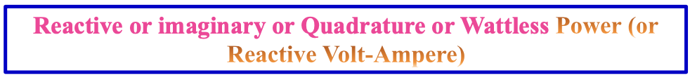
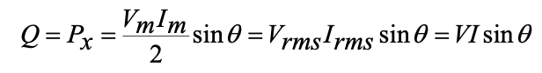
The maximum value of instantaneous reactive or imaginary or quadrature or wattless power (or instantaneous reactive volt-ampere) is called the reactive or imaginary or quadrature or wattless power (or reactive volt-ampere).
The unit of reactive power is called var (reactive volt-ampere).
The reactive power is measured by varmeter.
The instantaneous reactive or imaginary or quadrature or wattless power (or instanatneous reactive volt-ampere) can be written as follows:
Since the reactive power depends of the angle of sine, it may be positive (for capacitor) or negative (for inductor).

Slide 12

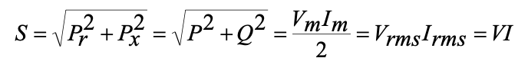
The volt-ampere or apparent power represents the maximum possible supply power by a source.
The apparent power can be obtained by combining the real and reactive power as follows:
The unit of apparent power is called VA (volt-ampere).

Slide 15

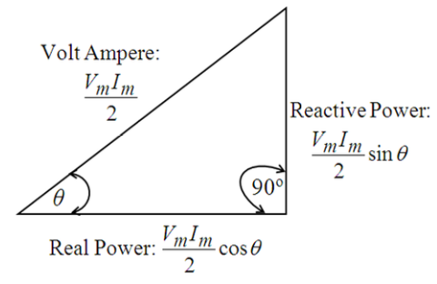
The power, reactive power and apparent power can be represented by graphically as shown in the following figure which is called Power Triangle.

Slide 16

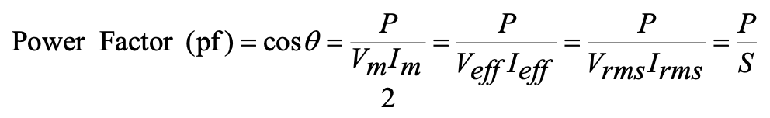
Cosine θ (cosθ) which is a factor, by which volt-amperes are multiplied to give power, is called power factor. Power factor is always positive.
Power factor can be given by:
Physical Significance of Power Factor
Power factor represents how much of maximum possible supply power is utilized (or consumed by resistor).
Suppose 0.5 power factor (i.e. 50% pf) of a circuit means that it will utilize only 50% of the apparent power whereas 0.8 power factor means 80% utilization of apparent power.
For this reason, we wish that the power factor of the circuit to be near 1 (unity) as possible.

Slide 17
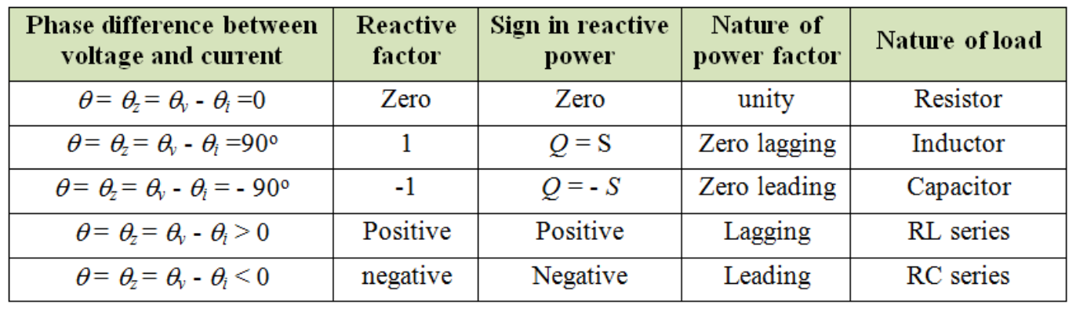

Slide 18
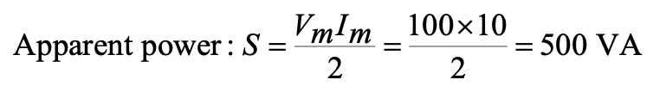
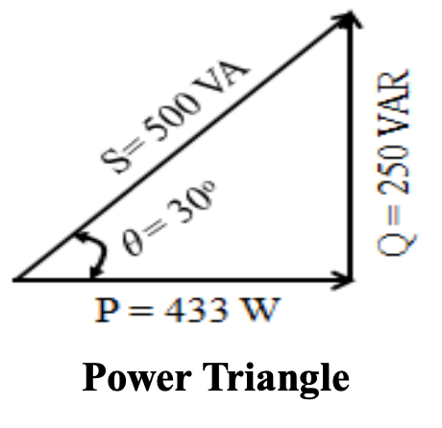
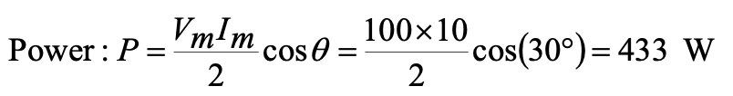
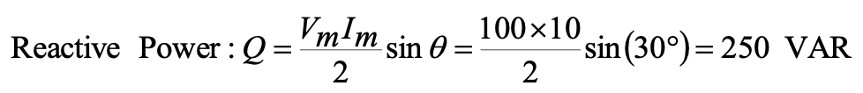

Slide 19
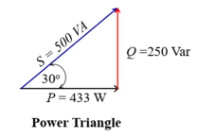
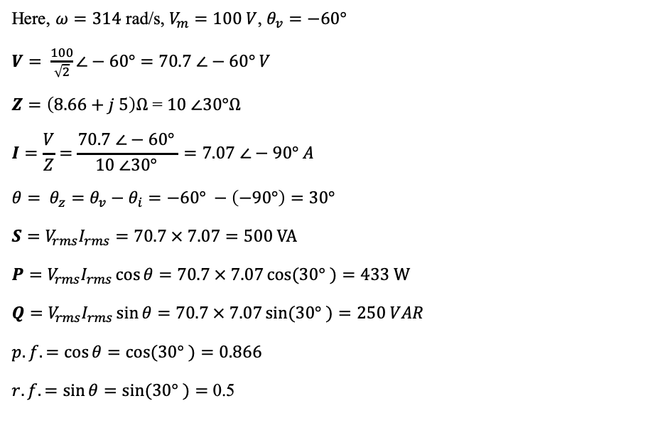
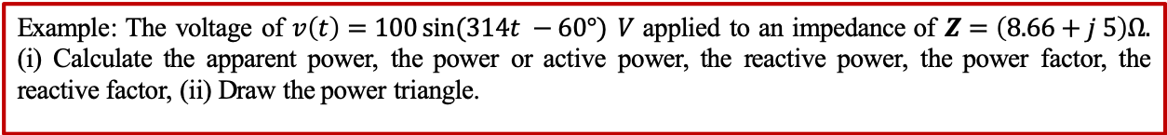
Example: The voltage of $v\left(t\right)=100\sin{(314t −60°)} V$ applied to an impedance of $Z=\left(8.66+j 5\right)Ω.$ (i) Calculate the apparent power, the power or active power, the reactive power, the power factor, the reactive factor, (ii) Draw the power triangle.
Example on Power Calculation
Here, $ω=314$ rad/s, $V_{m}=100 V$, $θ_{v}=−60°$
$V= \frac{100}{\sqrt{2}}∠−60°=70.7$$∠−60° V$
$Z=\left(8.66+j 5\right)Ω$ = $10$$∠30°Ω$
$$I=\frac{V}{Z}=\frac{70.7 ∠−60° }{10 ∠30° }=7.07 ∠−90° A$$
$$θ= θ_{z}=θ_{v}−θ_{i}=−60° −\left(−90°\right)=30°$$
$$S=V_{rms}I_{rms}=70.7 × 7.07=500 VA$$
$$P=V_{rms}I_{rms}\cos{θ}=70.7 × 7.07\cos{(30° )}=433 W$$
$$Q=V_{rms}I_{rms}\sin{θ}=70.7 × 7.07\sin{(30° )}=250 VAR$$
$$p.f.=\cos{θ}=\cos{(30° )}=0.866$$
$r.f.=\sin{θ}=\sin{(30° )}=$ 0.5

Slide 20
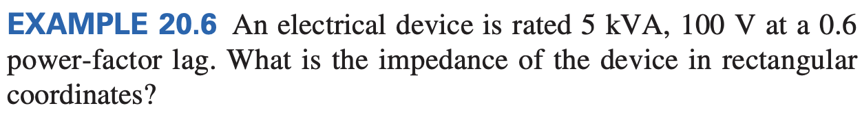
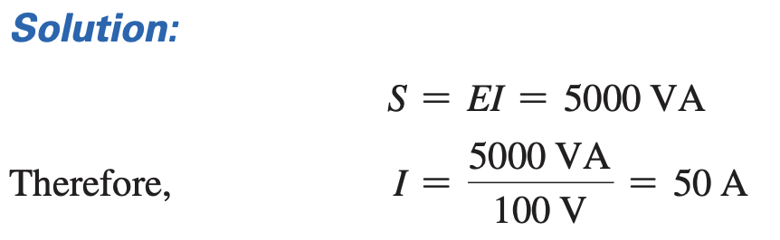
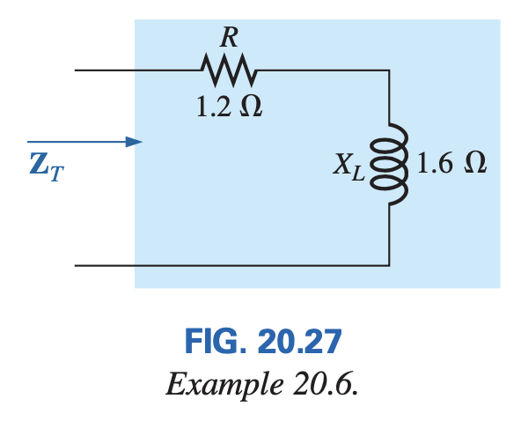
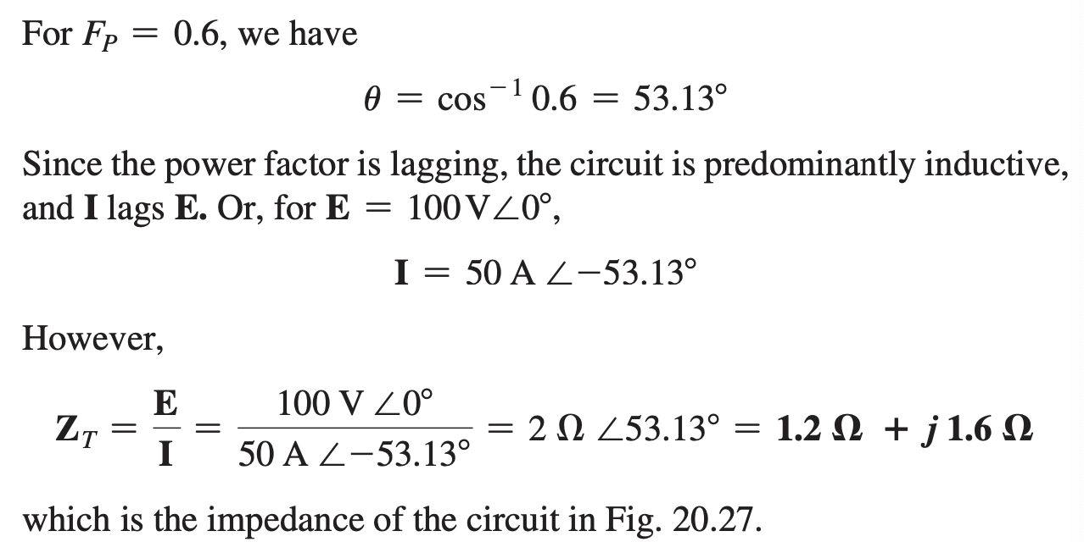

Slide 21


Slide 22
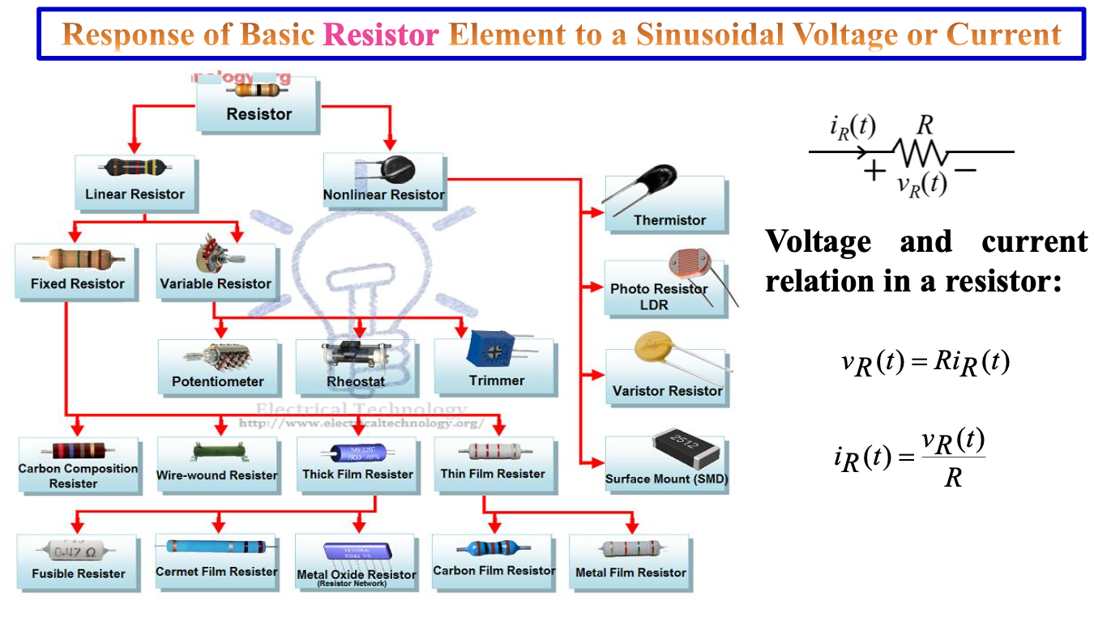

Slide 23
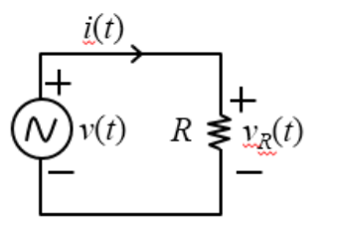
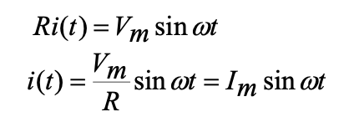
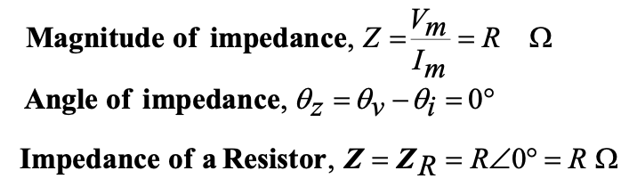
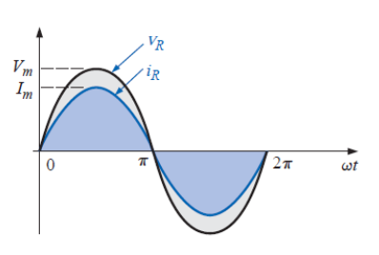
The phase difference between voltage across and current through a resistor is zero.
For a purely resistive element, the voltage across and the current through the element are in phase.

Slide 24

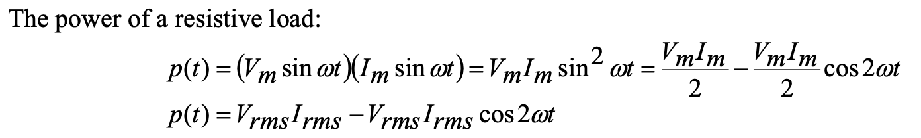
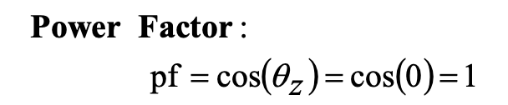
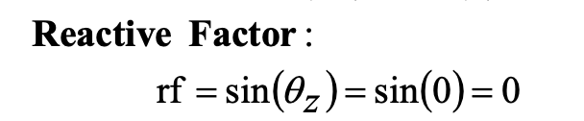
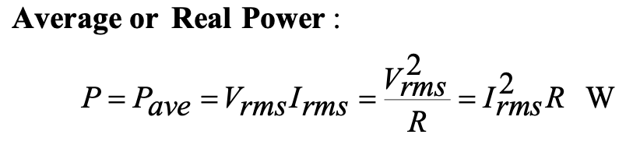
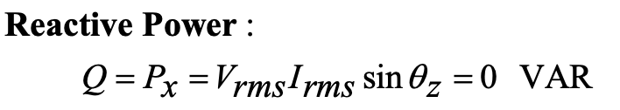
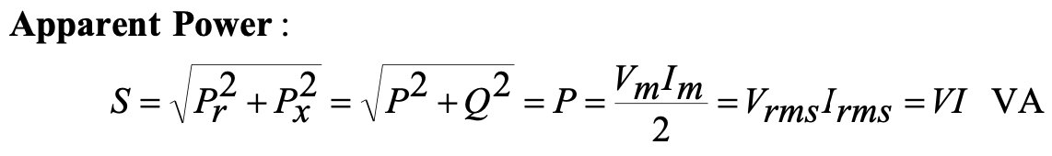
For resistive load, the power factor is 1 which called unity power factor.

Slide 26
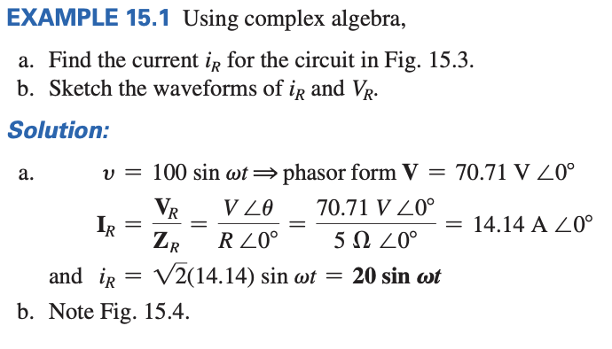
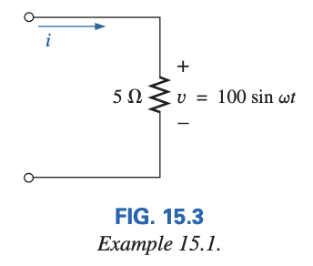
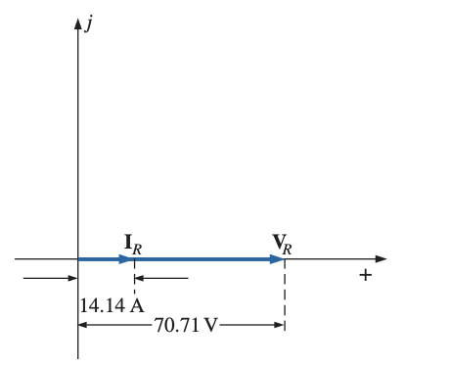
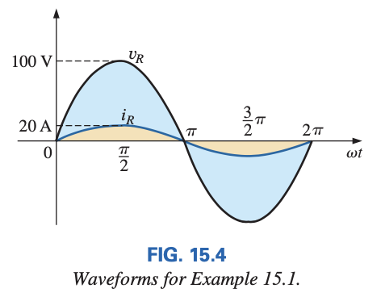

Slide 27
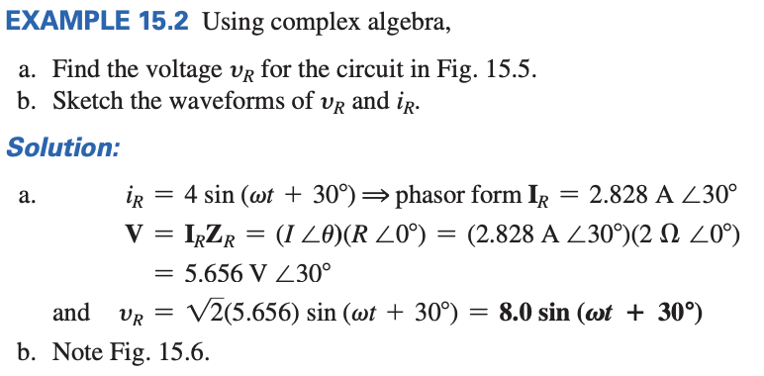




Slide 28


Slide 29


Slide 30


Slide 31


Slide 32






Impedance of Inductor, Z = Z_{L} = X_{L} ∠90° = j X_{L} Ω
The phase difference between voltage across and current through an inductor is 90º .
For a purely inductive element, the voltage leads the current through the inductive element by 90º . Or, the current lags the voltage in an inductive element by 90º.

Slide 33





Slide 34





Slide 35


Slide 36



Slide 37
Thank You

